Slide 1
Telkwa’s School Growth Plan
2026 - 2029

Slide 2
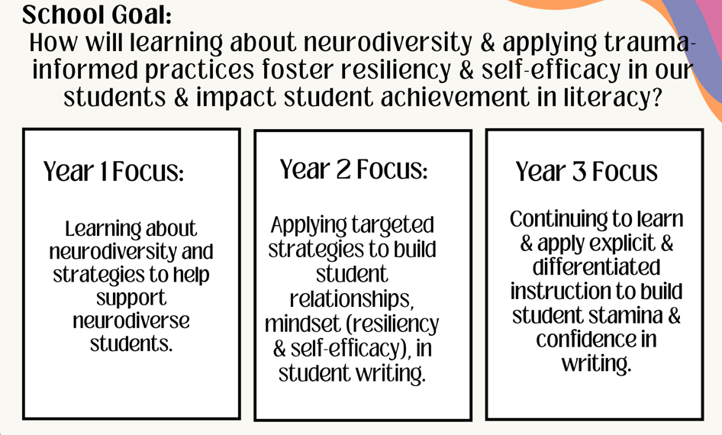
From years past……2022 - 2025

Slide 3
Reading Data 2024-2025: Fall to Spring

Slide 4
Writing Data 2024 -2025…..Fall to Spring

Slide 5
Taking a Look at our Student Learning Surveys
2022 I feel I am getting better at writing (most/all of the time) | 2023 I feel I am getting better at writing (most/all of the time) | 2024 I feel I am getting better at writing (most/all of the time) | 2025 I feel I am getting better at writing (most/all of the time)
Grade 4: 66% | Grade 4: 73% | Grade 4: 85% | Grade 4: 79%
Grade 7: 53% | Grade 7: 92% | Grade 7: 85% | Grade 7: 60% (has dropped)
Writing:
Reading:
2022 I feel I am getting better at reading (most/all of the time) | 2023 I feel I am getting better at reading (most/all of the time) | 2024 I feel I am getting better at reading (most/all of the time) | 2025 I feel I am getting better at writing (most/all of the time)
Grade 4: ? | Grade 4: 87% |  | Grade 4: 94%
Grade 7: ? | Grade 7: 73% |  | Grade 7: 60% (has dropped)

Slide 6
FSA RESULTS – Fall 2024

Slide 7
What is the Data Telling Us?
Literacy
* What we have implemented in a targeted approach to reading and writing is working
* Continue with focus on explicit strategies
SLS
FSA
FSA results showed that we are performing lower in numeracy than in literacy
SLS indicated a number of gr.6 expressed that they were stressed.

Slide 8
Where to Next – Future School Goals
Numeracy Goal ?
2026/27 focus on Numeracy goal
common pedagogy and instructional approaches/strategies that are familiar from grade to grade. – Math UP,(split grade lessons/content all there) number sense, Number operations.
Problem solving- focus on math competencies and using emotion to drive learning.. How to introduce a math problem that allows for student buy in- ie pizza boxes in hallway, egg drop, Rockets etc.
Maintenance mode:
Self Regulation ?
Whole school approach
2026 focus on self reg practices

Slide 9
Telkwa Elementary 2026-2029
School goal:
How will learning through self-regulation strategies & neurodiverse informed practice foster resiliency in our students & impact student achievement in numeracy and literacy.
Year 1 Focus
Year 2 Focus
Year 3 Focus
Maintain our literacy goal while continuing to develop explicit and differentiated strategies to build student stamina and confidence in numeracy.
Develop explicit and differentiated strategies in numeracy that build our students stamina in numeracy while also building self regulation strategies.
Create a common language that is recognized by all students of TES that builds their fluency in numeracy, literacy and self regulation.

